Slide 1

k-NN Graph Based Pneumonia Detection System
R.V SELLO [ 223019265 ]
R SEBEYI [ 223002956 ]
T HLOPHE [ 221019829 ]

Slide 2
Project Description
Pneumonia is a serious lung infection that affects millions globally, making early and accurate detection is crucial for effective treatment.
This project seeks to explore a novel graph-based approach to pneumonia detection from chest X-ray images, aiming to enhance both the accuracy and explainability of the diagnosis process.
K-Nearest Neighbour Graphs are going to be used for content-based image retrieval, classification, and similarity measures.

Slide 3
Problem
Current pneumonia detection methods primarily use deep learning, which often lacks transparency in decision-making.
Traditional deep-learning methods for pneumonia detection rely on convolutional neural networks (CNNs), this approach has the following disadvantages:
Limited Generalization to Diverse Data
Lack of Interpretability
Sensitivity to Noise and Artifacts

Slide 4
Solution
To enhance the accuracy and interpretability of pneumonia detection, we propose utilizing K-Nearest Neighbour (K-NN) Graphs for content-based image retrieval, classification, and similarity analysis.
In this approach, each chest X-ray image is represented as a node within a graph, and edges are formed between images based on visual or feature-space similarity.
This structure enables the system to retrieve and compare images with similar patterns, facilitating more reliable classification by referencing known cases.
By leveraging neighbourhood information, the K-NN graph aids in identifying subtle pathological features and improving diagnostic consistency. This method also supports better explainability, as clinicians can visually inspect similar cases used in the decision-making process.

Slide 5
Data Structures & Algorithms
Data Structures
Array List – To store biographical information for each patient and their chest x-ray scan.
Priority Queue – To store nodes in a sorted ordered.
Algorithms
K-NN – To perform similarity and classification

Slide 6
FIELD OF APPLICATION
Health Care Industry

Slide 7
IMPACT ON THE SOCIETY
Offer Affordable Health Care
Having this system will help health care institutions, to decrease cost of medical services as this system doesn’t require a lot of medical staff to operate it.
Early Detection & Treatment
Patients will be immediately diagnosed and given treatment, instead being rescheduled for diagnosis now and then due to lack of staff.

Slide 8
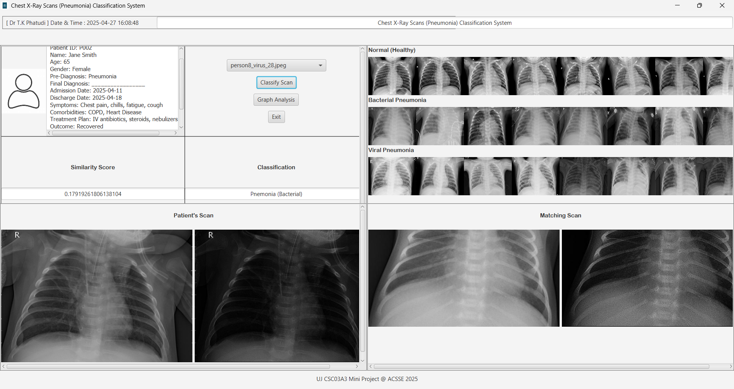
INTERFACE

Slide 9
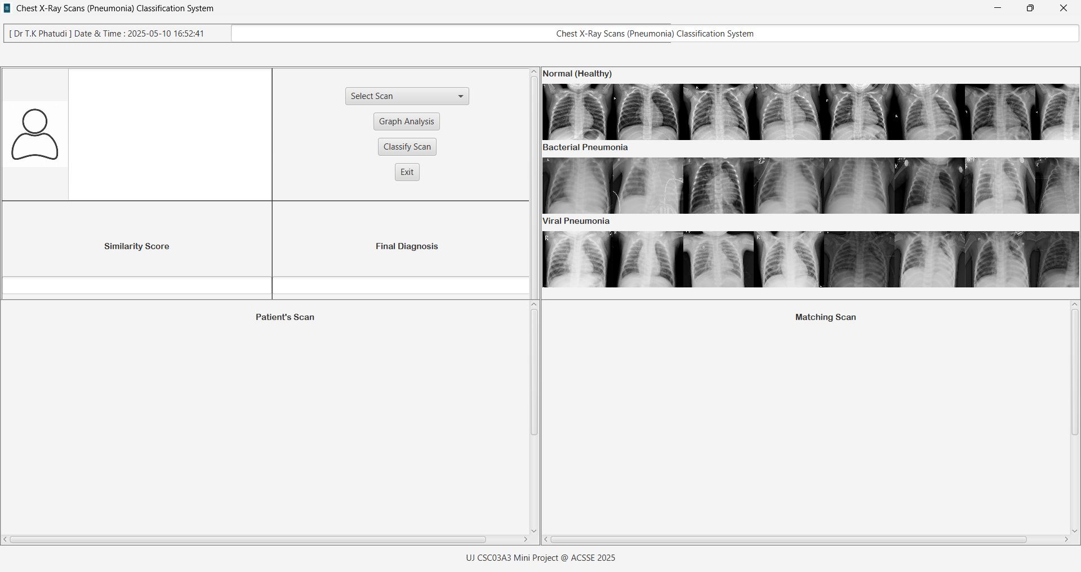

Slide 10
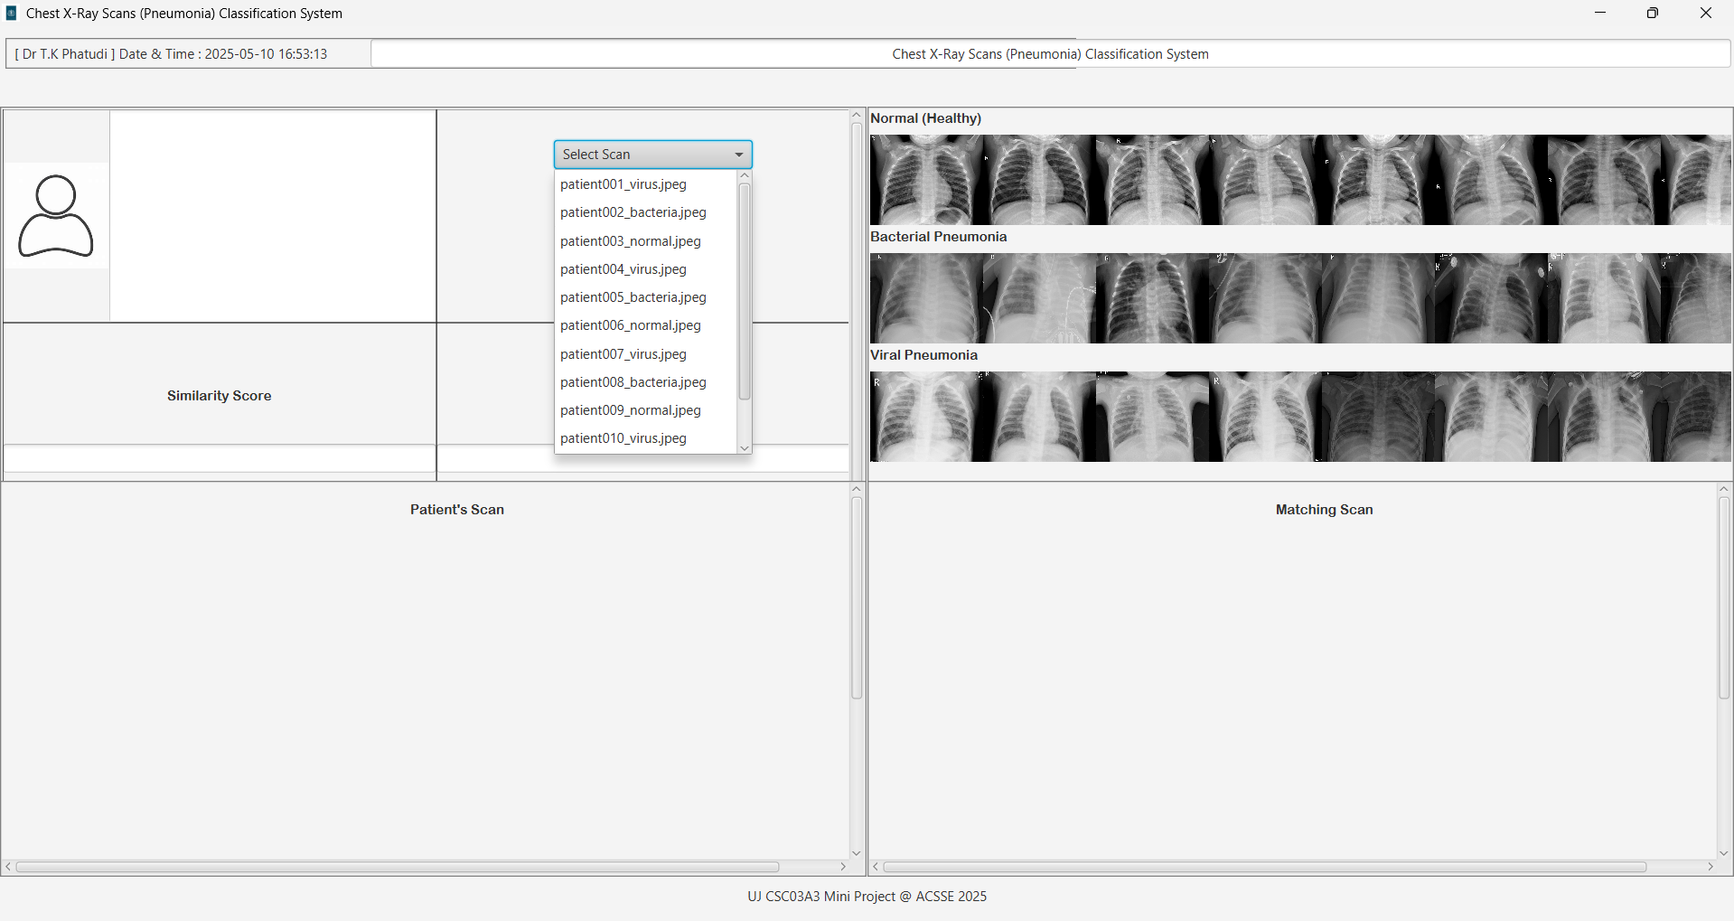

Slide 11
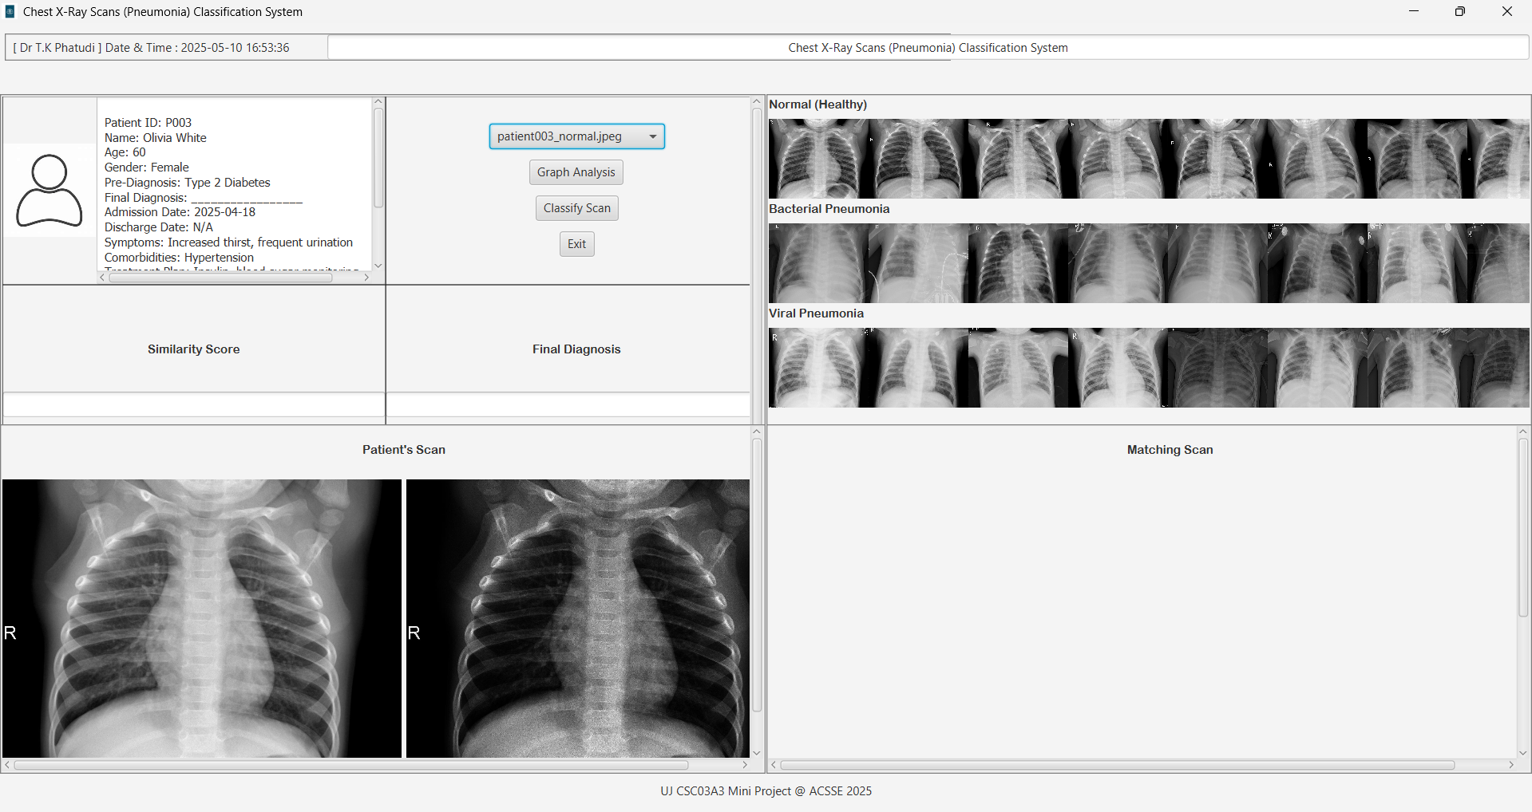

Slide 12
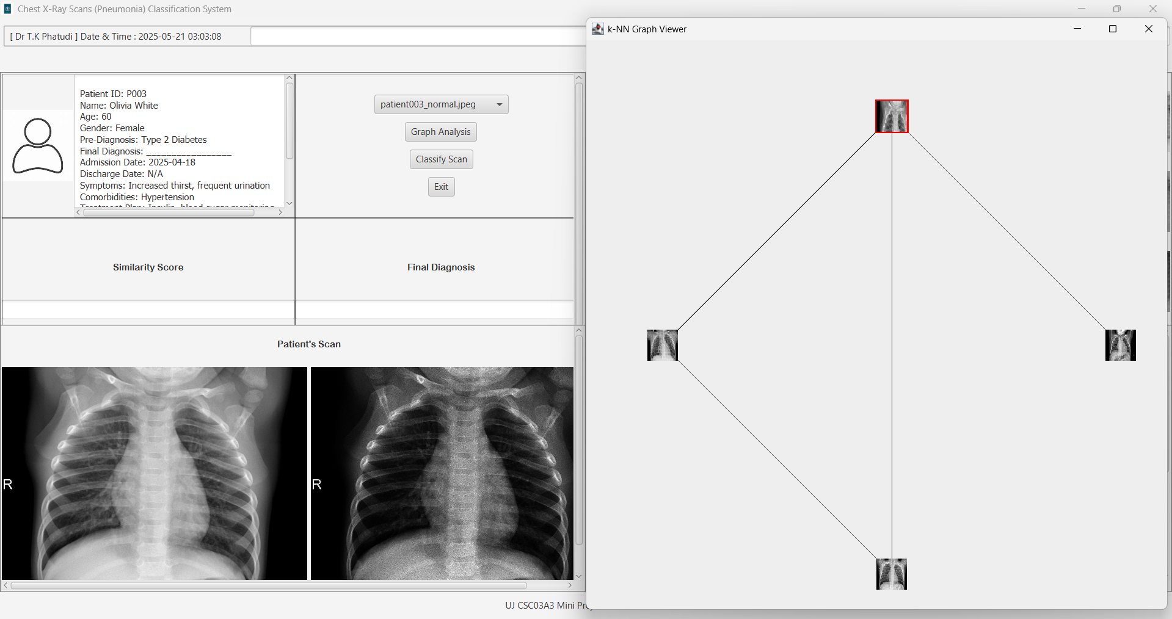

Slide 13
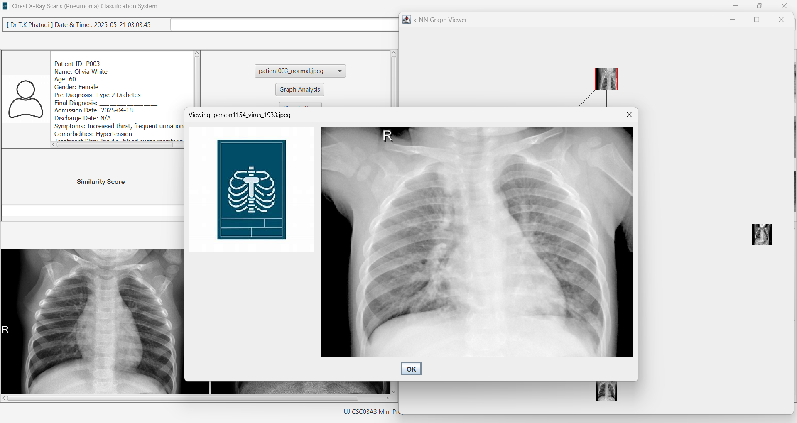

Slide 14
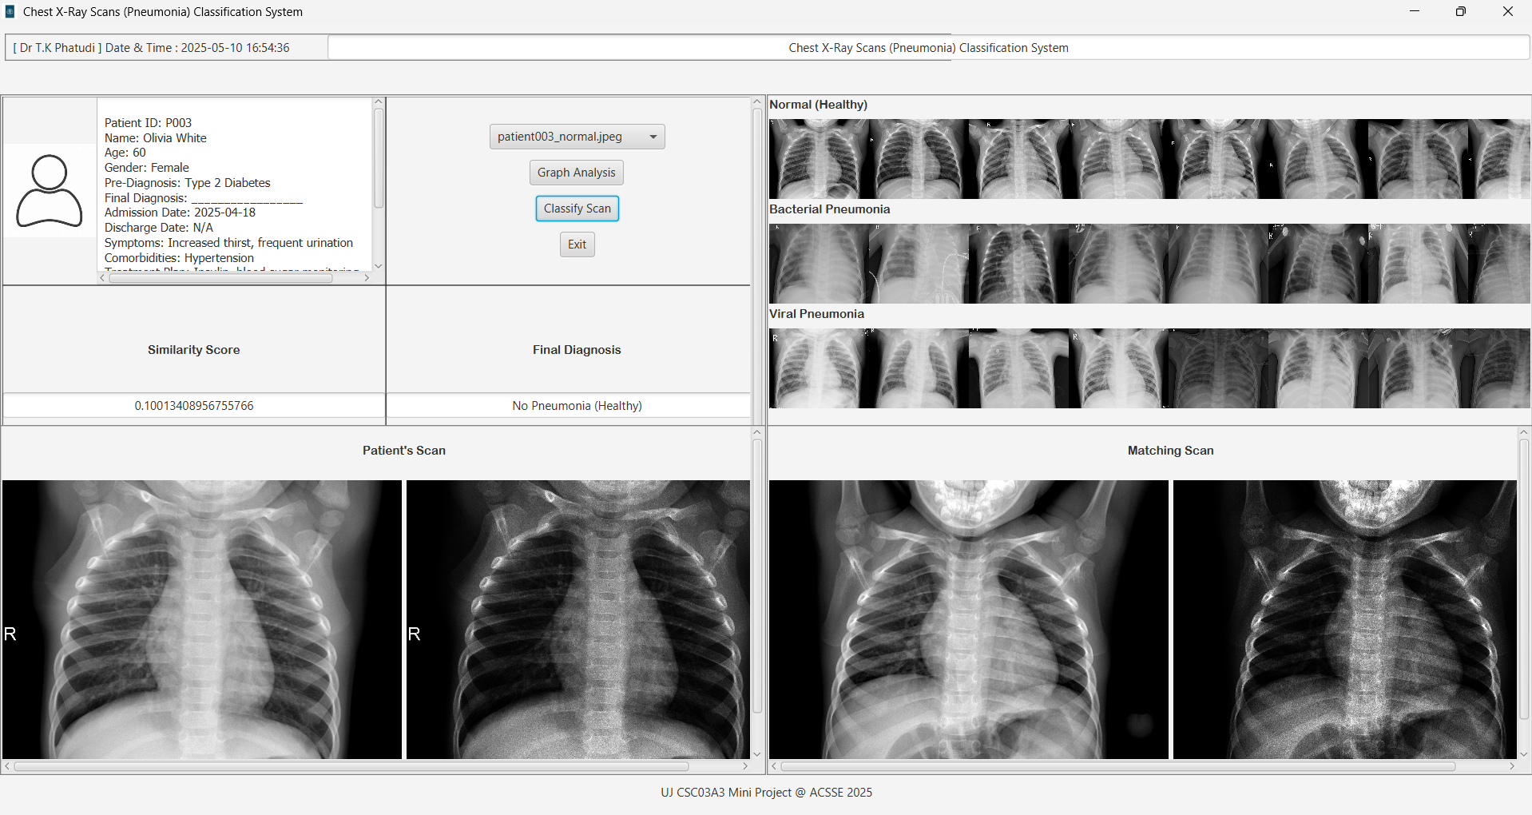

Slide 15
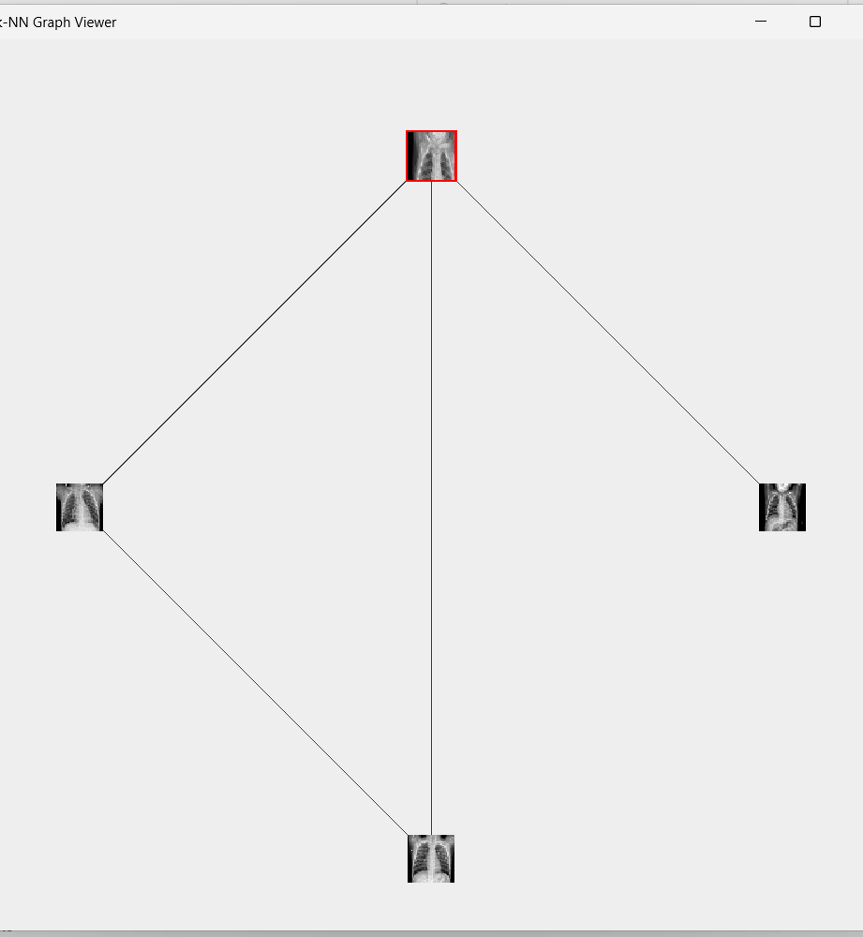
K-NN Graph Viewer
This window of the interface displays k-NN Graph, nodes are made up by the current patient scan being processed and the existing scans in the dataset. The nodes are mapped together by using their Euclidean distance.
Users can view a scan at a particular node by just clicking the node.

Slide 16
LIMITATIONS
K-NN Graphs can be computationally expensive with larger datasets.
Realtime processing could be slow with larger datasets
The system might not be able to handle images with high resolution well.

Slide 17
TRAINNING & RESULTS
Initially we used 30 images in the dataset
After doubling the number of images for training the accuracy increased.
We can conclude that the larger the dataset, the higher the accuracy.

Slide 18
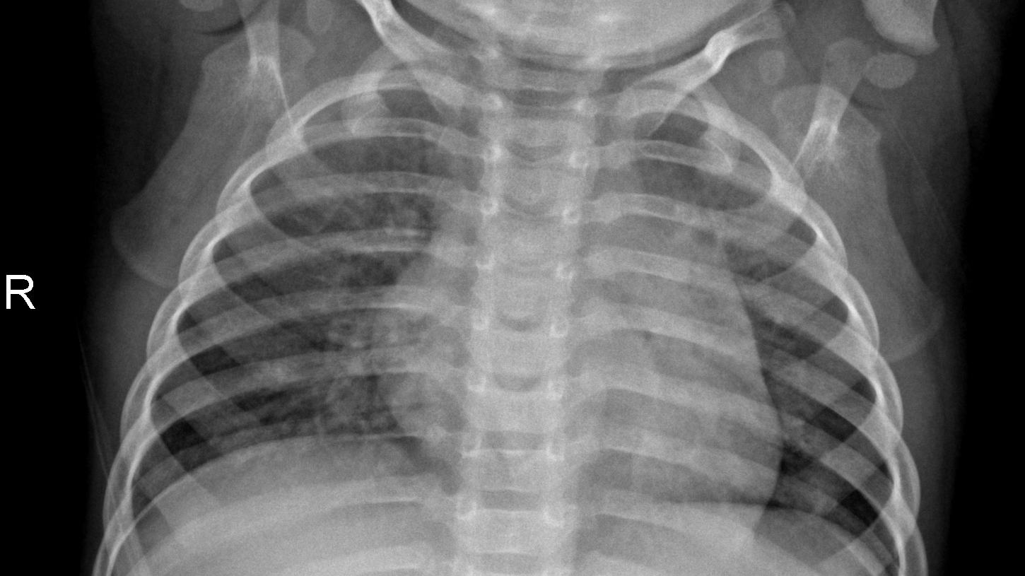
THE END

